Slide 1
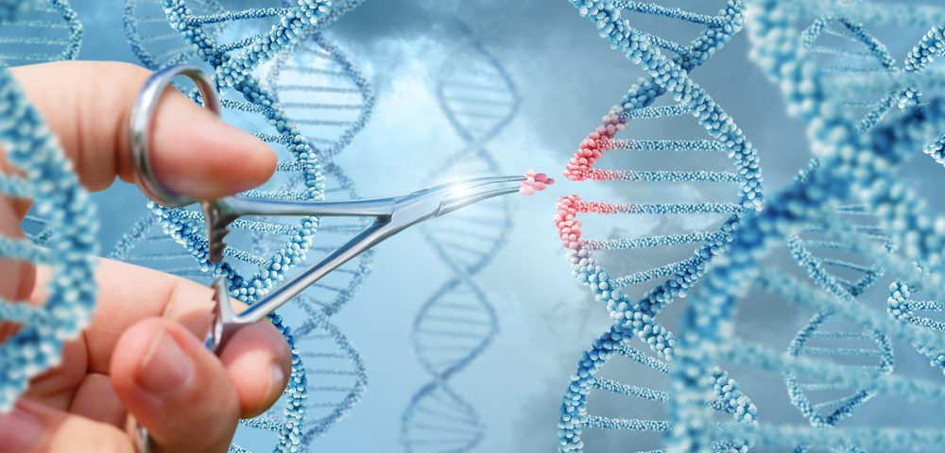

Application of CRISPR/Cas9 on CAR-T Therapy
Group H
Xu Haotai, Che Xuanming, Han Yujia, Han Yuanzhe
Notes:
Hello everyone, our group will talk about application of crisper/cas9 on CAR-T therapy

Slide 2
Group H
Introduction
Apply CRISPR/Cas9 on CAR-T
How CRISPR/Cas9 Works
Conclusion and Outlook
CONTENTS
Notes:
Our talk will be divided into four parts
Introduction
Apply CRISPR/Cas9 on CAR-T
details in CRISPR/Cas9
And Expectations

Slide 3
Group H
Part 1 Introduction

Slide 4
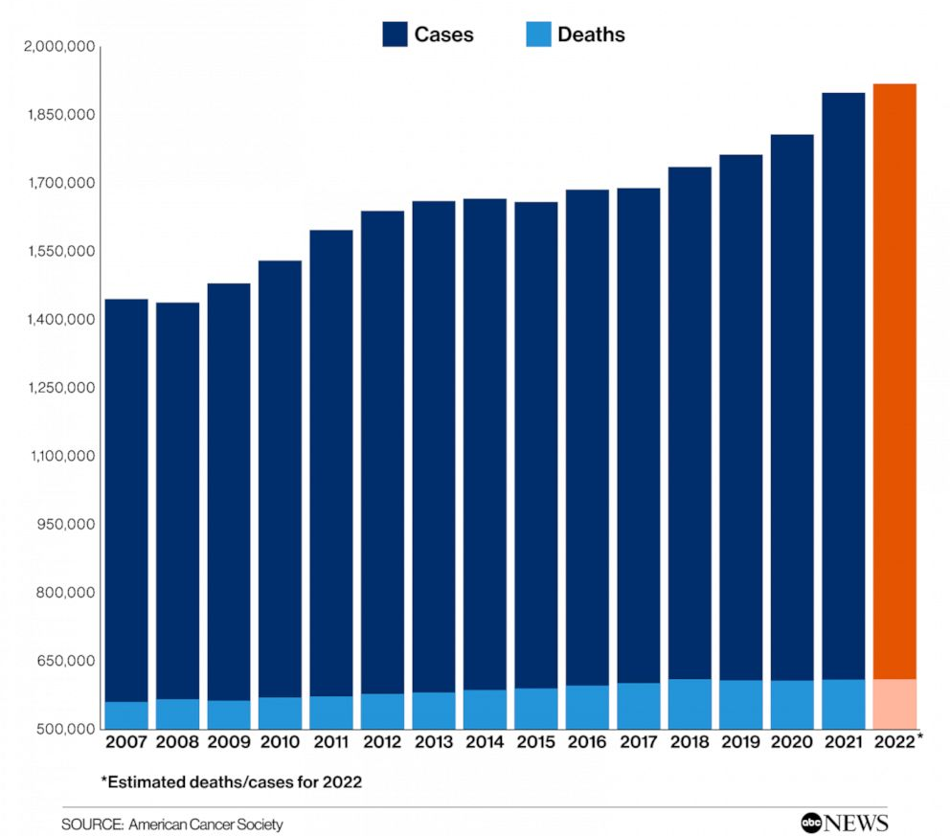
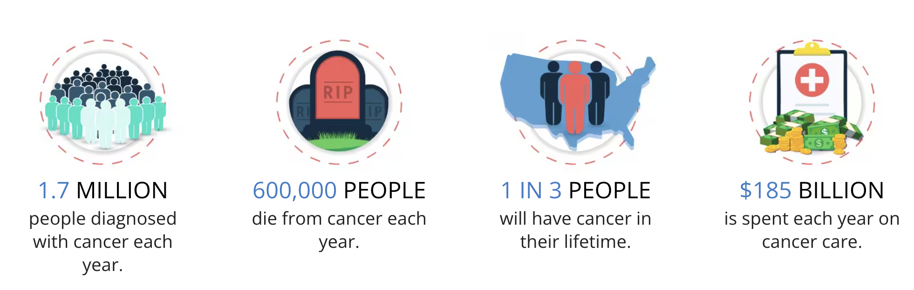
Group H
The number of cases of cancer in 2022 will increase by 32% compared to 2007 [1]
Numerous
High mortality rate
Dangerous
The mortality rate is about 30%
Figue.1 Estimated Cancer Caces and Death in the U.S.[1]
Figure.2 Cancer data in the United States[2]
Notes:
If you were to think of a terrible disease, what would come to your mind?
I think about cancer.
Over the past few decades, Cancer is still an incurable disease which is a non-negligible factor in death
The number of cases is increasing and the proportion of deaths is still high
The fight against cancer has never stopped in the long history

Slide 5
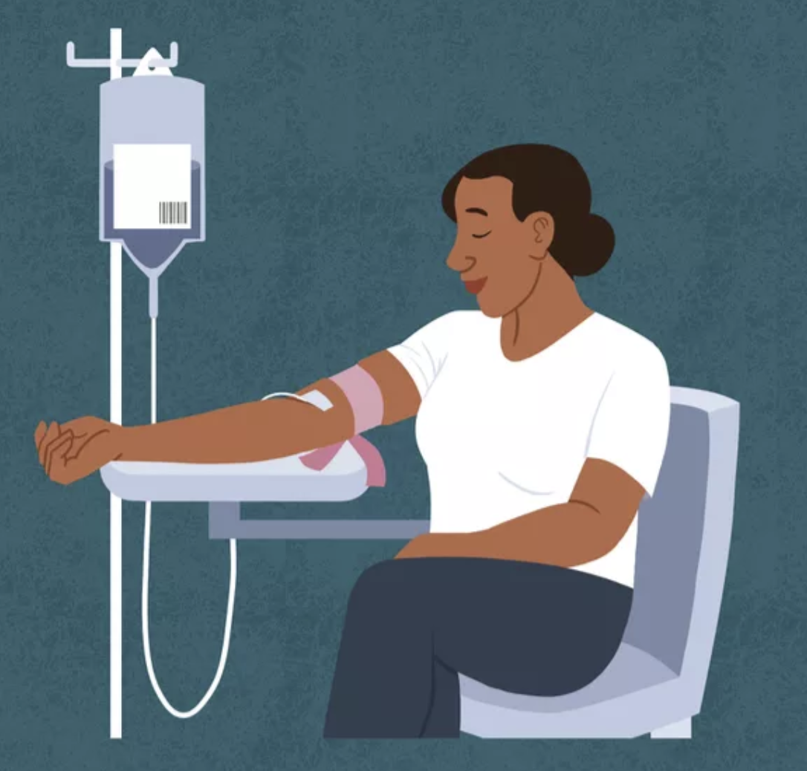
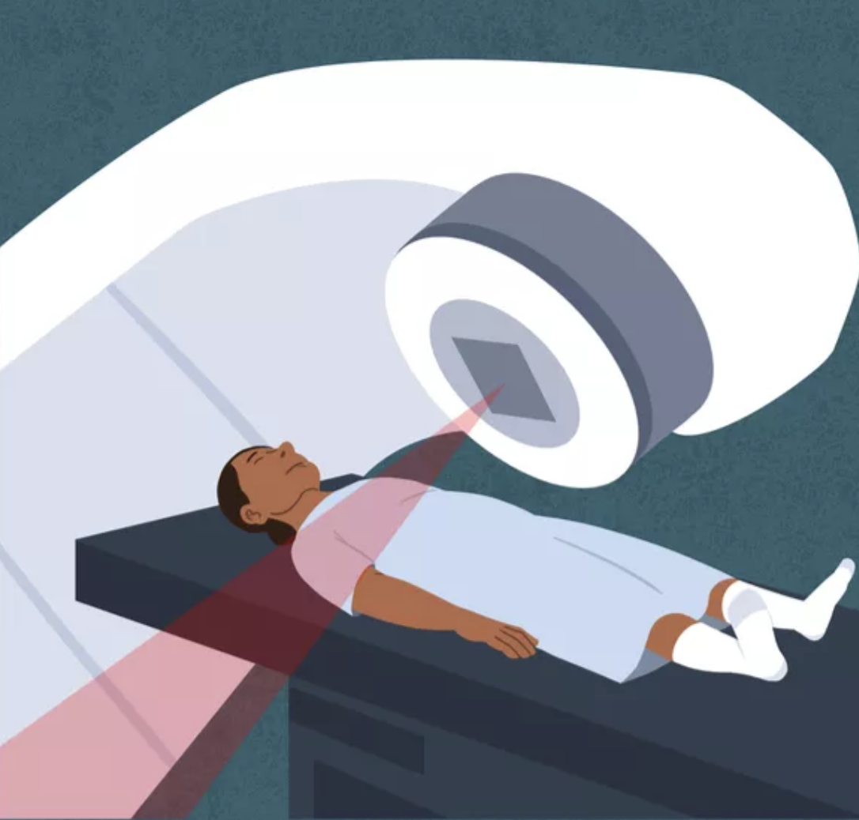
Group H
Harmful
Chemotherapy
Radiotherapy
and
Damage normal cells
Vomiting
Low red blood cells
Possible to recur
Damage normal cells
Feeling tired
Hair loss
Possible to recur
Notes:
,there were two treatments were often used
chemotherapy and radiotherapy .
But the short comes are very serious.
Such as they are also harmful to healthy cells not only to tumor cells
Because none of these treatments are good, scientists have come up with a new approach
化疗的缺点是对癌细胞和正常细胞都有杀伤，即所谓“伤敌一千自损八百”。
当癌细胞对化疗耐药之后，化疗不仅不能起到抑制癌症的正面作用，反而只剩下摧毁正常细胞的负面作用了。
化疗杀伤的正常组织对人体影响比较关键的是免疫细胞，以及肠道菌群，这些都直接影响人体自身对肿瘤的免疫力，以及影响免疫治疗的效果。也就是说，化疗到了耐药的阶段，不仅化疗本身无效，而且连免疫治疗的机会都被化疗给毁了
放疗的缺点主要有两方面，一是放疗是局部性治疗，对于游离在病灶之外的肿瘤细胞则无法对治；二是放疗会对正常组织有伤害，尤其是会让正常组织纤维化，导致日后的大出血猝死
How do people fight cancer
The usual therapies are chemotherapy and radiation therapy with surgery. But the short comes are very serious.
Such as they are also harmful to healthy cells not only to tumor cells

Slide 6
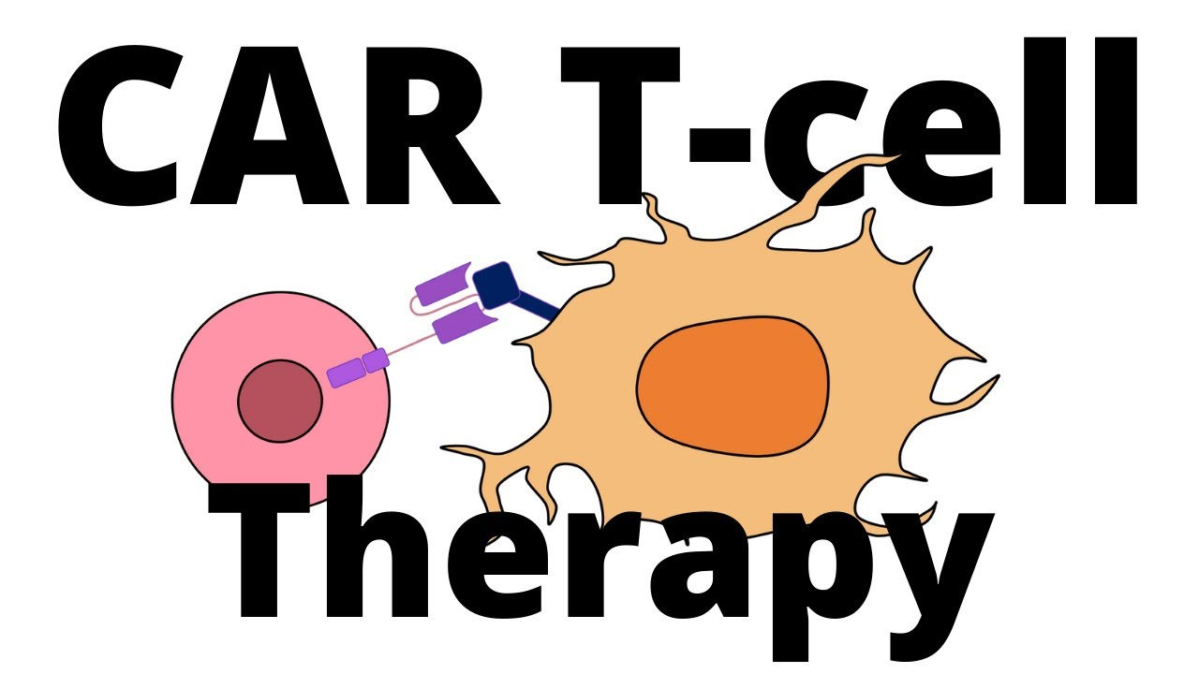
Group H
A new method
Figure.3 CAR-T therapy
Notes:
Let's look at the mechanism of cancer
Why is cancer so dangerous? We all know that T cells are crucial immune cells in our bodies. They help fight viruses and keep us healthy. But cancer cells have a special substance on their surface that helps them hide from T cells, making it hard for T cells to do their job. Traditional treatments like chemotherapy and physical therapy can be very harmful to our bodies. But scientists have developed a new method called CAR-T. This method helps T cells recognize and destroy cancer cells more accurately. In simple terms, CAR T cells are the key to this new treatment.

Slide 7
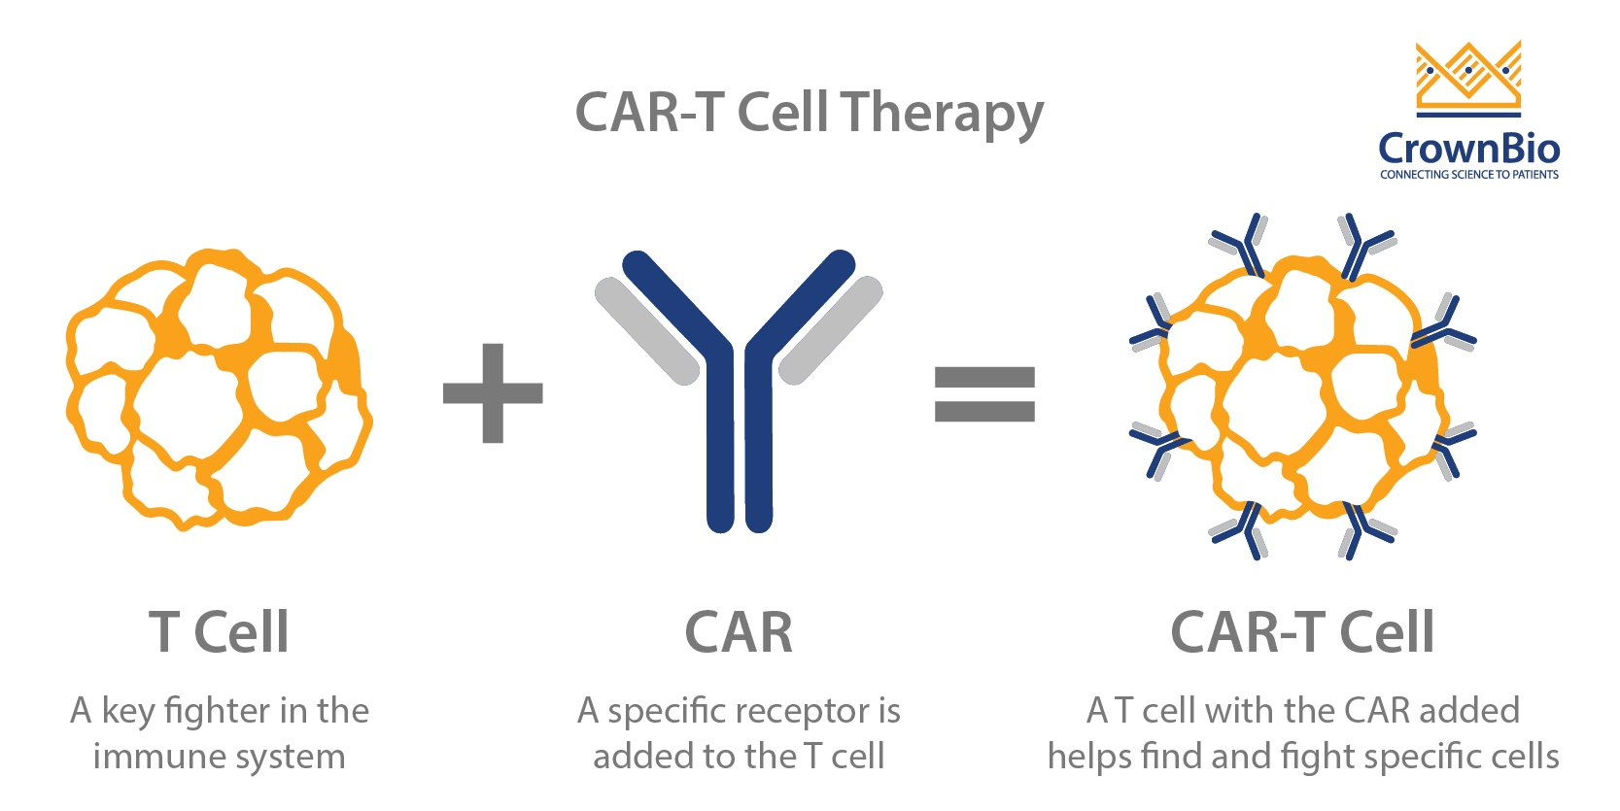
Group H
Therefore, CAR-T provides a low-side-effects and long-lasting therapy to cure cancer.
Figure 4. CAR-T Cell [3]

Slide 8
Group H
Part 2 Apply CRISPR/Cas9 on CAR-T

Slide 9
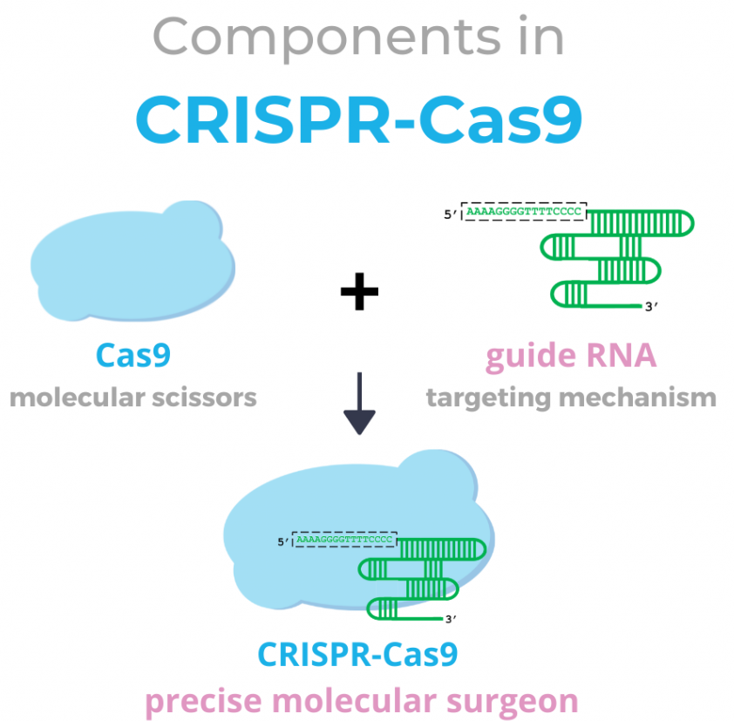
Group H
CRISPR/Cas9 is a gen-3 genome edition technology
high accuracy
High efficiency
Multifunction
Let CAR-T enter clinical application
Figure 5. The structure of the CRISPR-Cas9[4]

Slide 10
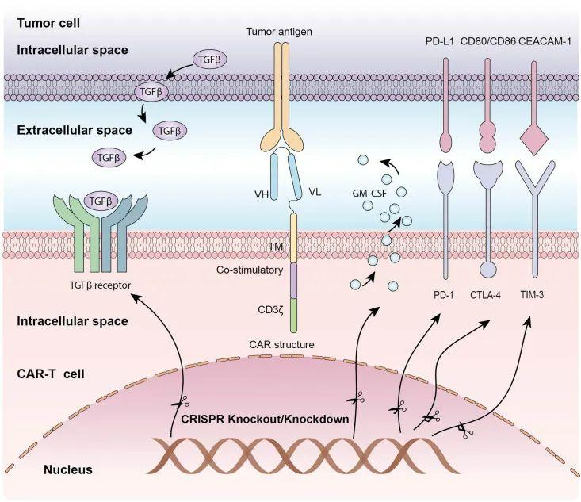
Group H
Immune checkpoints cause the death of T-cell
PD-1/PD-L1
CTLA-4/CD80(CD86)
TIM-3/CEACAM-1
GM-CSF factor
TGFβ factor
Stimulate the growth of tumor cell
CAR structure
Tumor antigen
Identify the tumor cell
Knock out the gene which stop T cell’s killing and help the escape of tumor cell.
Modify the gene to enhance the killing efficiency of T cell. [4]
Figure.6 Application of CRISPR/Cas9 system in genome edition of CAR-T cell [4]

Slide 11
Group H
Part 3 How CRISPR/Cas9 Works

Slide 12
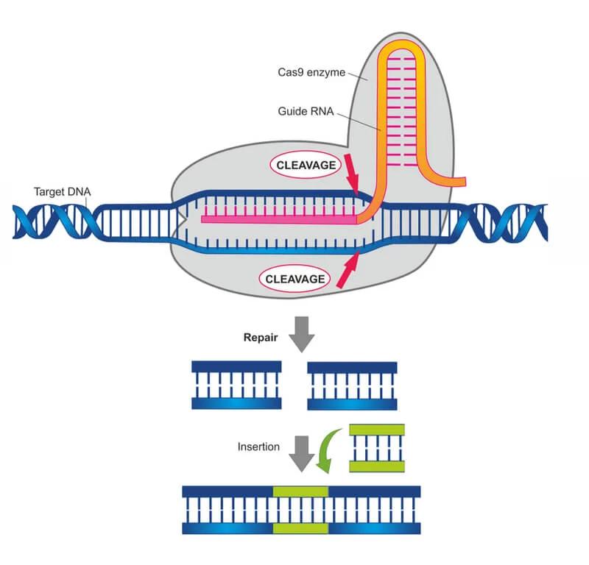
Group H
CRISPR／Case９
Cutting
Insertion
Figure 7. The principle of the CRISPR-Cas9[5]
Therefore, CRISPR/Cas9 play an important role in Car-T cell Therapy.

Slide 13
Group H
accuracy
practicability
The advantage of
CRISPR/Cas9
simplicity
prospection

Slide 14
Group H
Part 4 Conclusion and Outlook

Slide 15
Comparision
Group H
Chemotherapy[6] | Radiation Therapy[7] | Targeted Medicine Therapy[8] | CAR-T[9]
Non-selective hurting | Non-selective hurting | Only targeted on tumor cells | Only targeted on tumor cells
Chemical based | Radiation based | Bio-centered chemical | Immune cells from patient
All cancer | All cancer | Specific cancers | Specific cancers
Relative cheap | Relative cheap | Relative expensive | Very expensive
Most accessible | Most accessible | Relative less accessible | Difficult to access
Relative bad prognosis | Relative bad prognosis | Optimistic prognosis | Very good prognosis
Possible to recur | Possible to recur | Relatively less possibility to recur | Almost completely cure

Slide 16
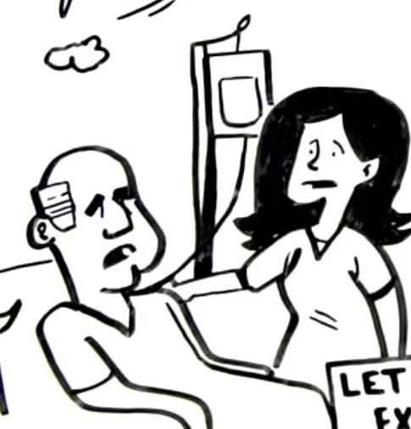
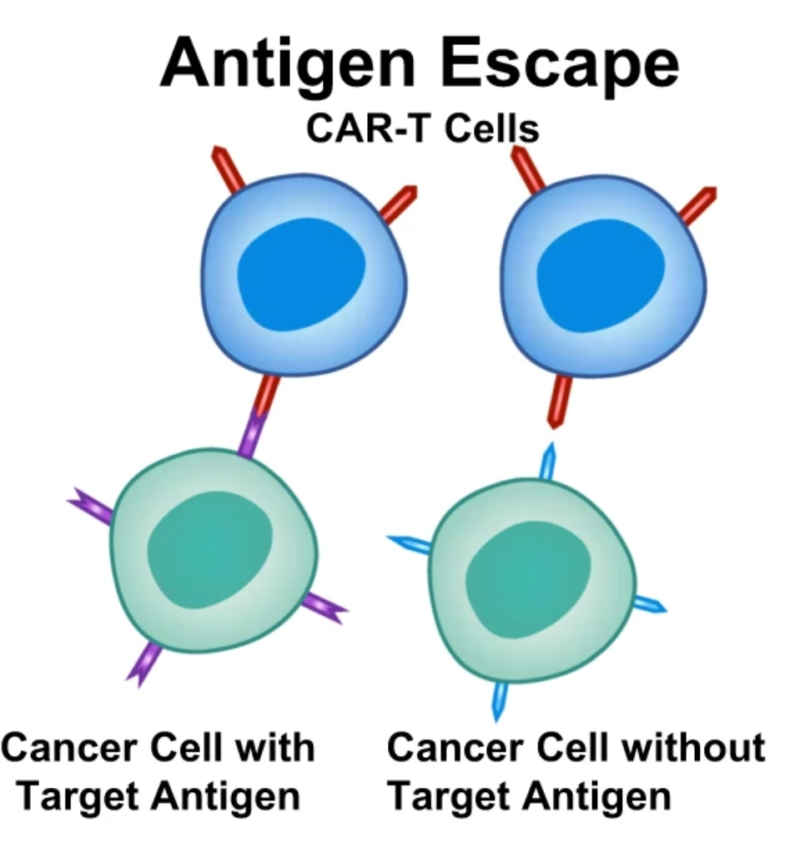
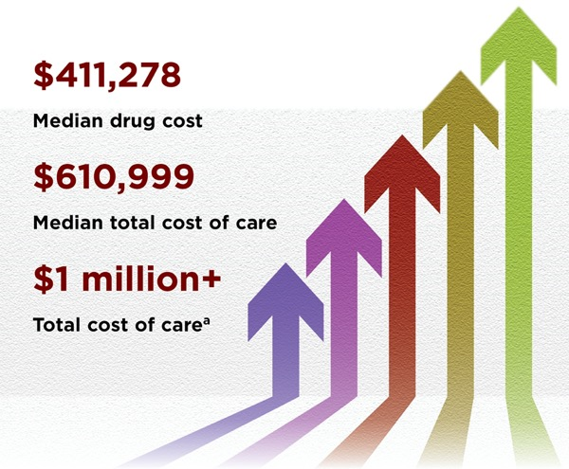
Disadvantage
Group H
Figure 8. The cost of CART T-cell therapy.[10]
Toxic reaction
Antigen Escape
Expensive

Slide 17
Expectations
Group H
1. Reduce the side-effect
2. Research for more common cancers
3. decrease the cost

Slide 18
Reference
Group H
[1] Mary Kekatos, Nearly 2 million cases of cancer likely to be diagnosed in 2022: Report, (https://abcnews.go.com/Health/million-cases-cancer-diagnosed-2022-report/story?id=82204749)
[2] National Center for Chronic Disease Prevention and Health Promotion (NCCDPHP), Chronic Disease Fact Sheets, (https://www.cdc.gov/chronicdisease/resources/publications/factsheets/cancer.htm)
[3] Ludovic Bourré, How to evaluate CAR T cell therapy in preclinic, (https://www.crownbio.cn/2018-2-20/)
[4] Lester Quah, The CRISPR-Cas9 Genome Editing System, (https://blog.advanxhealth.com/the-crispr-cas9-genome-editing-system/)
[5] Clara Rodríguez Fernández, CRISPR-Cas9: The Gene Editing Tool Changing the World, (https://www.labiotech.eu/in-depth/crispr-cas9-review-gene-editing-tool/)
[6] Peter Nygren & Rolf Larsson. (2008) Predictive tests for individualisation of pharmacological cancer treatment. Expert Opinion on Medical Diagnostics 2:4, pages 349-360
[7] Baskar R, Lee KA, Yeo R, Yeoh KW. Cancer and radiation therapy: current advances and future directions. Int J Med Sci. 2012;9(3):193-9. doi: 10.7150/ijms.3635. Epub 2012 Feb 27. PMID: 22408567; PMCID: PMC3298009.
[8] Tsimberidou, AM. Targeted therapy in cancer. Cancer Chemother Pharmacol 76, 1113–1132 (2015). https://doi.org/10.1007/s00280-015-2861-1.
[9] Sterner, R.C., Sterner, R.M. CAR-T cell therapy: current limitations and potential strategies. Blood Cancer J. 11, 69 (2021). https://doi.org/10.1038/s41408-021-00459-7
[10] Gina Shaw, Hospitals Still Grappling With $1 M+ Price Tag for CAR-T Rx, (https://www.pharmacypracticenews.com/Clinical/Article/10-21/Hospitals-Still-Grappling-With-1-M-Price-Tag-for-CAR-T-Rx/64913?ses=ogst)

Slide 19
Group H
Thank you for your listening

Slide 20
Group H
B. The gene express the factor induce of the death of tumor cell
5’
3’
A. The gene express the factor stimulate the growth of tumor cells
C. The gene express immune factor to call on other immune cells
Knockout which one?

